Slide 1
Lecture 20
Graphs (II)

Slide 2
Outline
Topological Sorting
  Breadth First
  Depth First
Euler Paths and Circuits*

Slide 3
Topological Sorting (拓扑排序)
Let G be a directed graph with no cycles (DAG). A topological order for G is a sequential listing of all the vertices in G such that, for all vertices v,w∈G, if there is an edge from v to w, then v precedes w in the sequential listing.
The canonical application of topological sorting (topological order) is in scheduling a sequence of jobs or tasks; topological sorting algorithms were first studied in the early 1960s in the context of the PERT technique for scheduling in project management.

Slide 4
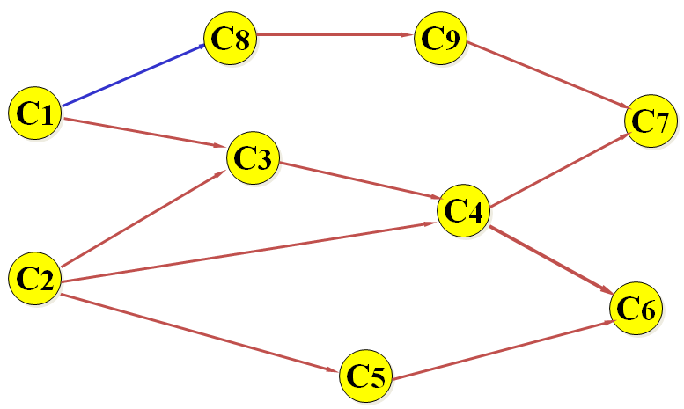
A DAG Example
课程代号 课程名称 先修课程
C₁ 高等数学
C₂ 程序设计基础
C₃ 离散数学 C₁, C₂
C₄ 数据结构 C₃, C₂
C₅ 高级语言程序设计 C₂
C₆ 编译方法 C₅, C₄
C₇ 操作系统 C₄, C₉
C₈ 普通物理 C₁
C₉ 计算机原理 C₈
学生课程学习工程图

Slide 5
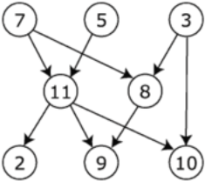
Example of Topological Sorting
The graph shown in the right has many valid topological sorts, including:
  7, 5, 3, 11, 8, 2, 9, 10 (visual left-to-right, top-to-bottom)
  3, 5, 7, 8, 11, 2, 9, 10 (smallest-numbered available vertex first)
  3, 7, 8, 5, 11, 10, 2, 9
  5, 7, 3, 8, 11, 10, 9, 2 (least number of edges first)
  7, 5, 11, 3, 10, 8, 9, 2 (largest-numbered available vertex first)
  7, 5, 11, 2, 3, 8, 9, 10

Slide 6
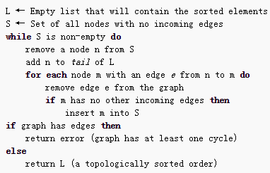
Topological Sorting: Breadth-First Algorithm
First, find a complete set of “source vertices" which have no incoming edges; at least one such node must exist if the graph is acyclic. Deleting all the outgoing edges of these source vertices will create new source vertices, which can then sit comfortably to the immediate right of the first set. We repeat until all vertices are accounted for.

Slide 7
Breadth-First Example for Topological Sorting
C0
C1
C2
C0
C1
C2
C3
C4
C5
C3
C4
C5
(a) DAG
(b) Output C4
C0
C1
C2
C1
C2
C3
C5
C3
C5
(c) Output C0
(d) Output C3

Slide 8
Breadth-First Example for Topological Sorting
The topological order: C₄ , C₀ , C₃ , C₂ , C₁ , C₅
C1
C2
C1
C5
C5
(e)Output C2
(f)Output C1
C5
(g)Output C5
(h) Finish

Slide 9
Topological Sorting: Breadth-First Algorithm
If the graph was a DAG, a solution is contained in the list L (the solution is not unique). Otherwise, the graph has at least one cycle and therefore a topological sorting is impossible.
The usual algorithms for topological sorting have running time linear in the number of nodes plus the number of edges, asymptotically, O(|V|+|E|).

Slide 10
Topological Sorting: Breadth-First Algorithm
有向图的存储形式的不同，拓扑排序算法的实现也不同。
基于邻接矩阵表示的存储结构，设A为有向图G的邻接矩阵，则有：
  找图G中无前驱的顶点——在A中找到值全为0的列
  删除以i为起点的所有弧——将矩阵中i对应的行全部置为0。
基于邻接表的存储结构：入度为零的顶点即为没有前驱的顶点，我们可以附设一个存放各顶点入度的数组indegree[]，则有：
  找G中无前驱的顶点——查找indegree[i]为零的顶点vi；
  删除以i为起点的所有弧——对链在顶点i后面的所有邻接顶点k，将对应的indegree[k]减1。

Slide 11
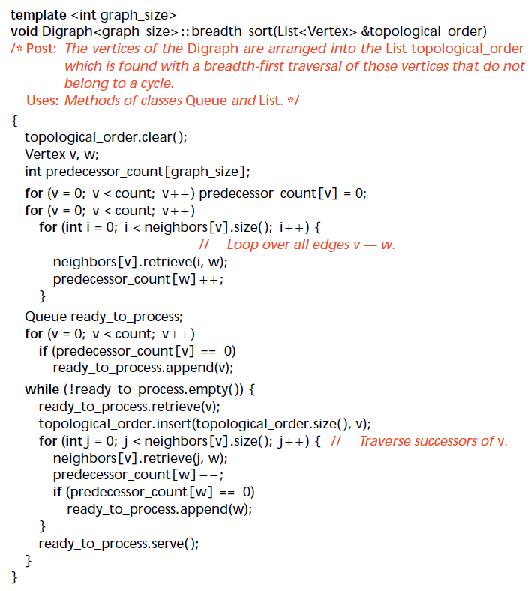
Topological Sorting: Breadth-First Algorithm

Slide 12
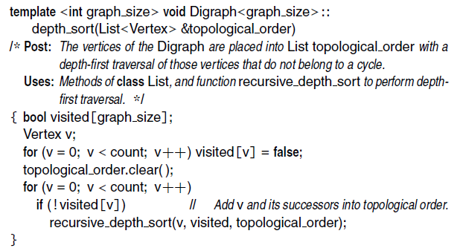
Topological Sorting: Depth-First Algorithm
Topological-Sort (G)
Call DFS(G) to compute finishing times f [v] for all v ∈ V
As each vertex is finished, insert it onto the front of a linked list
return the linked list of vertices
i.e., sorted from largest to smallest by finishing time

Slide 13
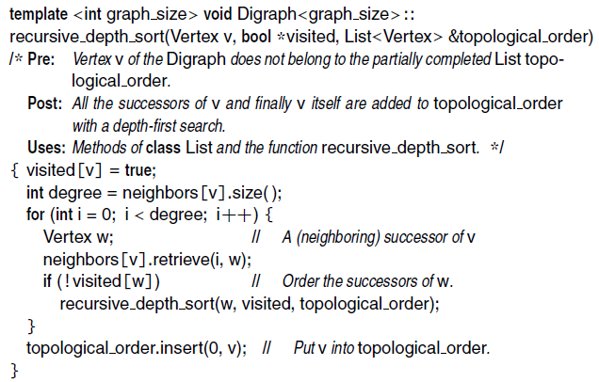
Topological Sorting: Depth-First Algorithm

Slide 14
Topological Sorting: Depth-First Algorithm
A
B
D
1/
C
E
Linked List:

Slide 15
Topological Sorting: Depth-First Algorithm
A
B
D
1/
2/
C
E
Linked List:

Slide 16
Topological Sorting: Depth-First Algorithm
A
B
D
1/
2/3
C
E
Linked List:
2/3
E

Slide 17
Topological Sorting: Depth-First Algorithm
A
B
D
1/4
2/3
C
E
Linked List:
1/4
2/3
D
E

Slide 18
Topological Sorting: Depth-First Algorithm
A
B
D
5/
1/4
2/3
C
E
Linked List:
1/4
2/3
D
E

Slide 19
Topological Sorting: Depth-First Algorithm
A
B
D
5/
1/4
6/
2/3
C
E
Linked List:
1/4
2/3
D
E

Slide 20
Topological Sorting: Depth-First Algorithm
A
B
D
5/
1/4
6/7
2/3
C
E
Linked List:
6/7
1/4
2/3
C
D
E

Slide 21
Topological Sorting: Depth-First Algorithm
A
B
D
5/8
1/4
6/7
2/3
C
E
Linked List:
5/8
6/7
1/4
2/3
B
C
D
E

Slide 22
Topological Sorting: Depth-First Algorithm
A
B
D
9/10
5/8
1/4
6/7
2/3
C
E
Linked List:
9/10
5/8
6/7
1/4
2/3
A
B
C
D
E

Slide 23
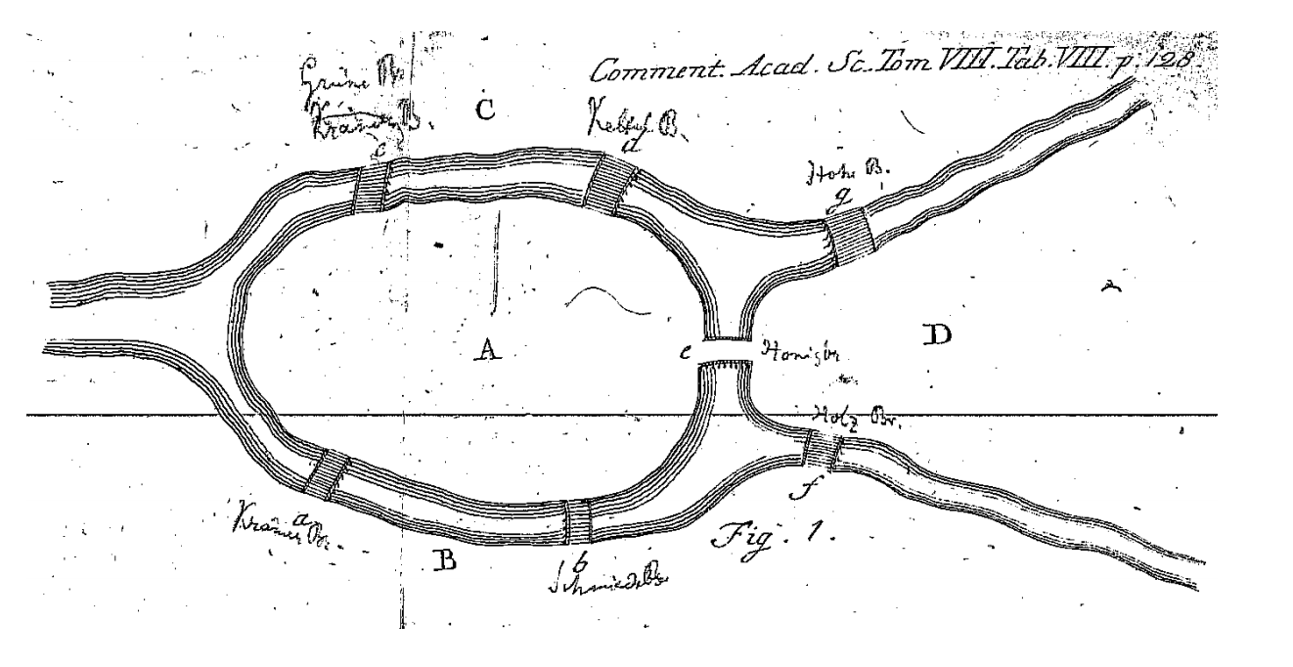
The Seven Bridges of Königsberg
An illustration from Euler’s 1741 paper on the subject.

Slide 24
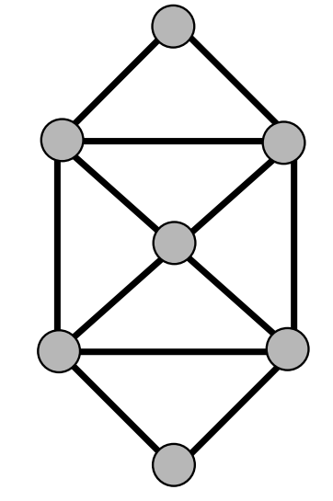
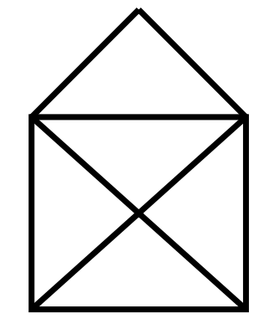

Puzzles
Can you traverse all edges exactly once, starting and finishing at the same vertex?

Slide 25
Euler Paths and Circuits
Euler Path: a path through a graph that visits each edge exactly once.
Euler Circuit: an Euler tour that starts and ends at the same vertex.
Observations:
  An Euler circuit is only possible if the graph is connected and each vertex has even degree (# of edges onto vertex).
  Why?
  At every vertex, need one edge to get in and one edge to get out!

Slide 26
The Handshaking Theorem
Theorem: In every graph, the sum of the degrees of all vertices equals twice the number of edges.
If there are n vertices V₁, . . . , V_{n}, with degrees d₁, . . . , d_{n}, and there are e edges, then
d₁ + d₂ + · · · + d_{n−1} + d_{n} = 2e
Therefore, d₁ + d₂ + · · · + d_{n} must be an even number.
The numbers d₁, d₂, · · · , d_{n} must include an even number of odd numbers.
Every graph has an even number of odd vertices.

Slide 27
Euler Circuit Theorem
If a graph is connected and every vertex is even, then it has an Euler circuit (at least one, usually more).
If a graph has any odd vertices, then it does not have an Euler circuit.

Slide 28
Euler Path Theorem
If a graph is connected and has exactly two odd vertices, then it has an Euler path (at least one, usually more). Any such path must start at one of the odd vertices and end at the other one.
If a graph has more than two odd vertices, then it cannot have an Euler path.

Slide 29
Finding Euler Circuits
Given a graph G = (V,E), find an Euler circuit in G.
Can check if one exists in O(|V|) time (check degrees).
To find an Euler path or an Euler circuit
  Fleury’s Algorithm
  DFS Algorithm

Slide 30
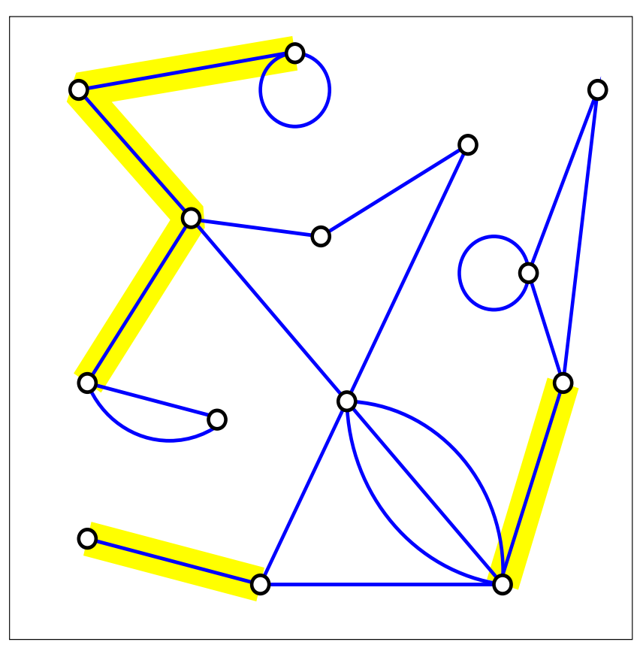
Fleury’s Algorithm: Bridges
Removing a single edge from a connected graph can make it disconnected. Such an edge is called a bridge.

Slide 31
Fleury’s Algorithm
Idea: Don’t burn your bridges.
Make sure the graph has either 0 or 2 odd vertices.
If there are 0 odd vertices, start anywhere. If there are 2 odd vertices, start at one of them.
Follow edges one at a time. If you have a choice between a bridge and a non-bridge, always choose the non-bridge.
Stop when you run out of edges.

Slide 32
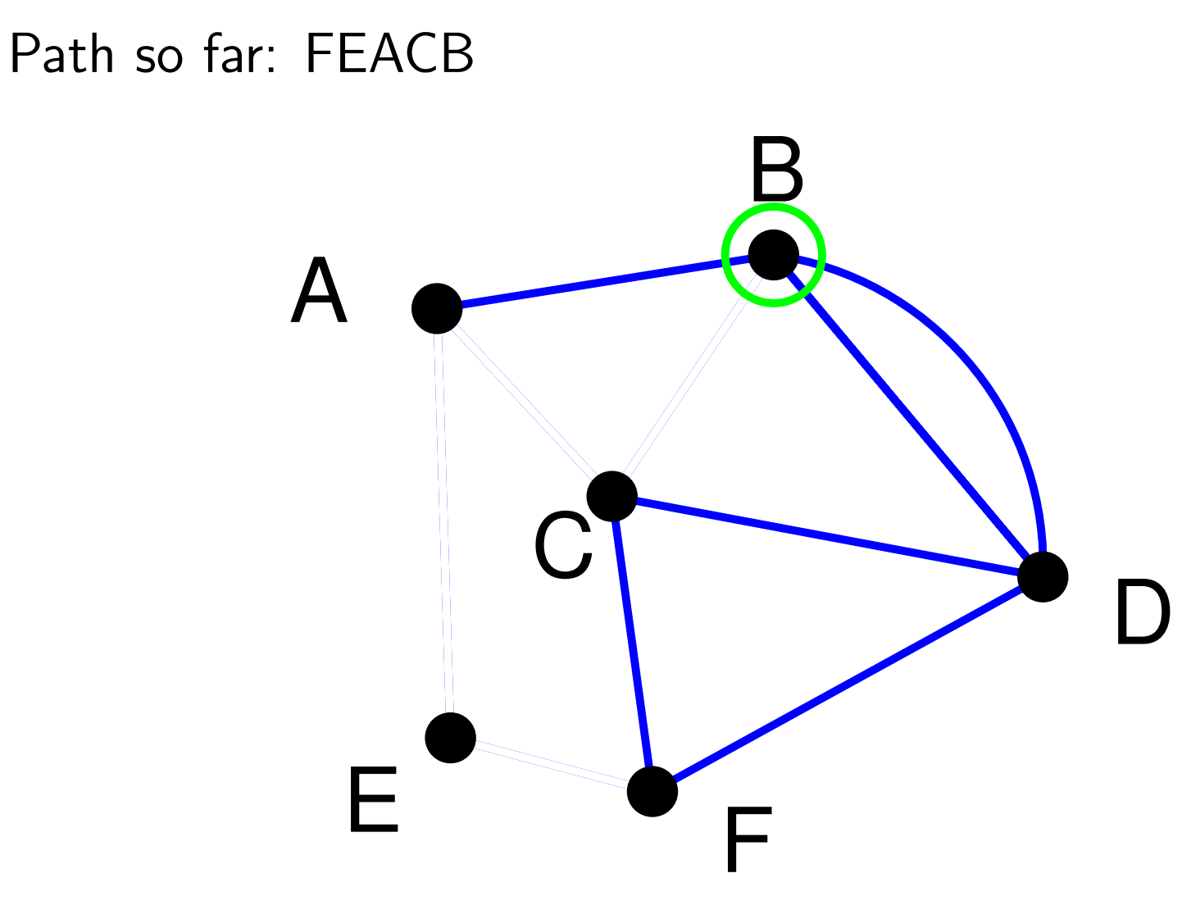
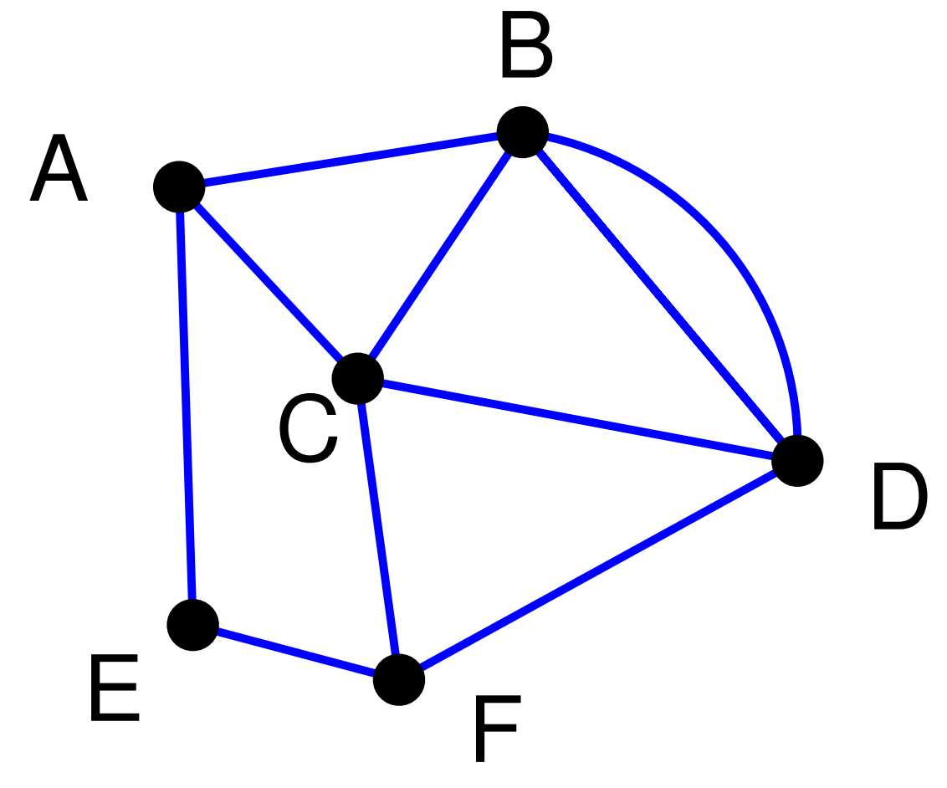
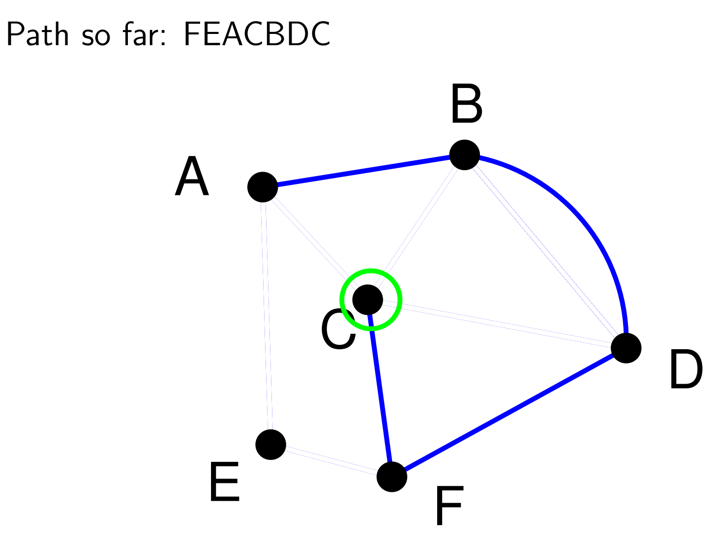
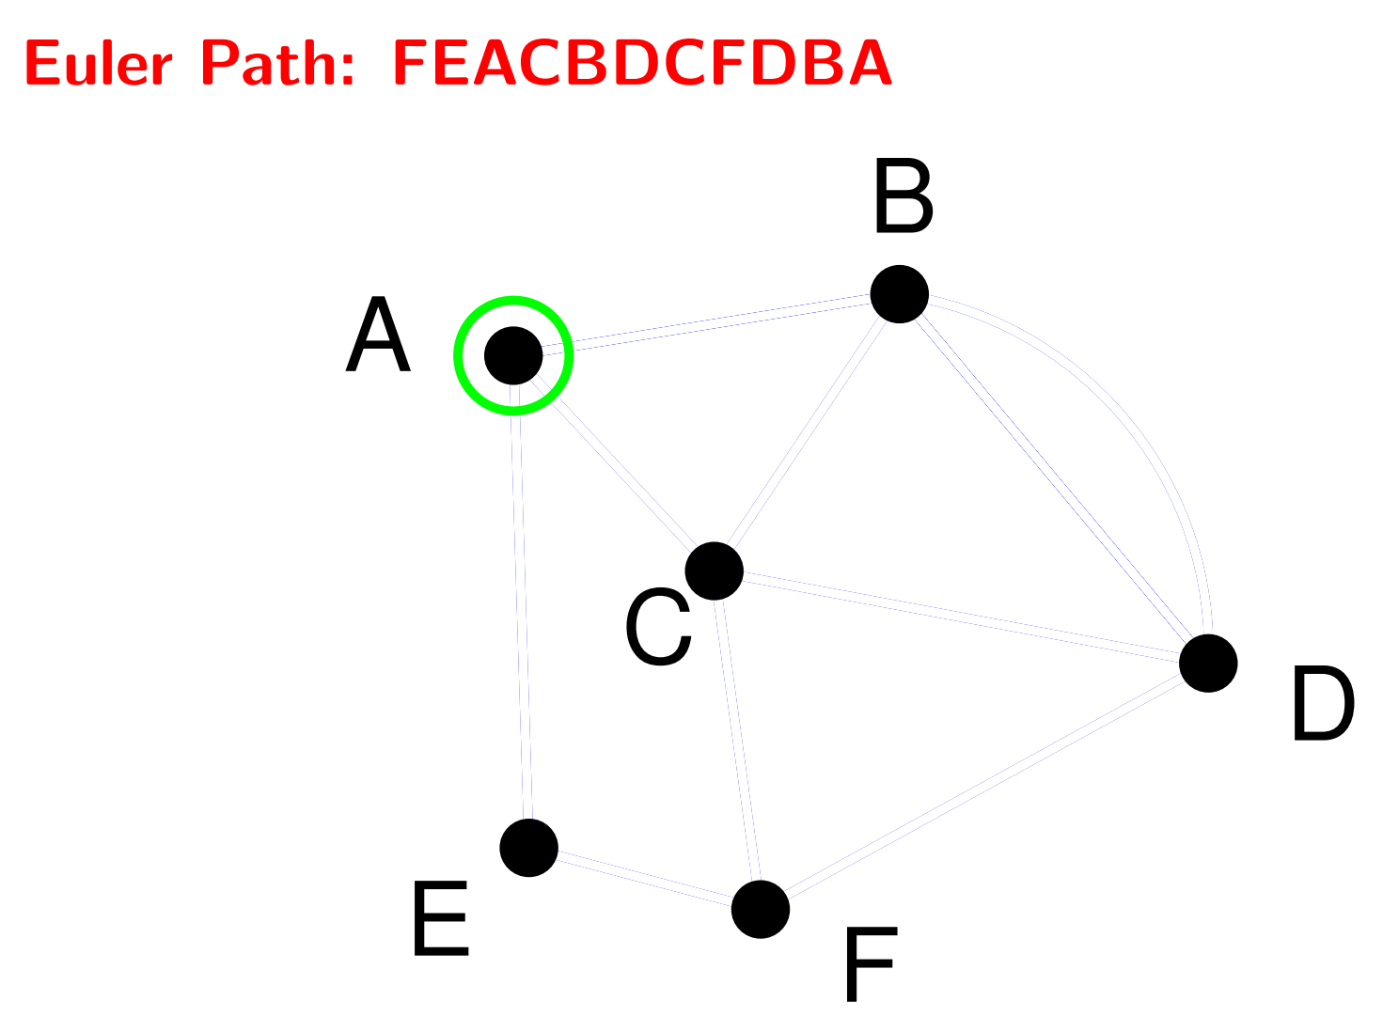
Example

Slide 33
Hierholzer's Algorithm
DFS and then Splice
Perform a depth-first search (DFS) from a vertex until you are back at this vertex.
Pick a vertex on this path with an unused edge and repeat 1.
Splice all these paths into an Euler circuit.
Running time = O(|V|+|E|).

Slide 34
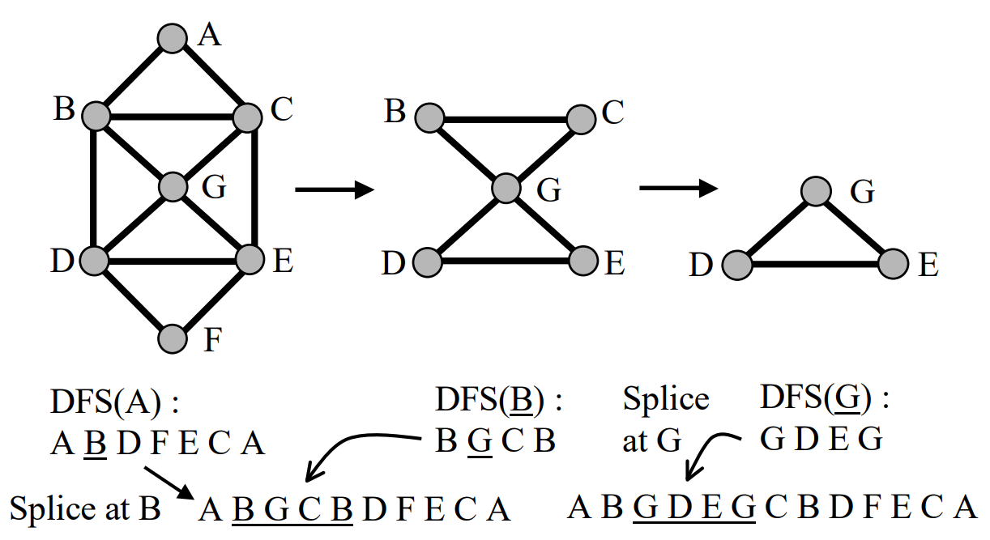
Example

Slide 35
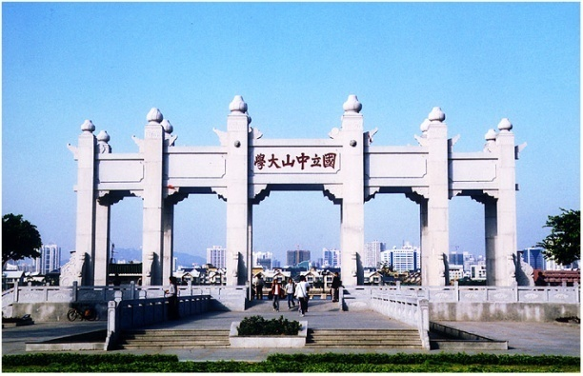
Thank you!

